Slide 1
PROJECT TITLE PREDICTING TRAFFIC CONGESTION IN LAGOS USING TRANSPORTATION DATA
PRESENTED BY:
AJANAH OBINNA GEORGE
COURSE:
DATA ANALYSIS

Slide 2
Introduction:
Data used in this project was sourced from opendataforafrica.org. Microsoft Excel was used to process the data and develop the visualization used in the report.

Slide 3
After data was sourced, it was categorized according to different time periods of the day, specifically:
Early Morning <12mid night – 4:59am>
Morning <5am – 11:49am>
Afternoon <12noon – 3:59pm>
Evening <4pm – 7pm>
Night <7:01pm – 11:59pm>
Furthermore, data was collected from eight locations across Lagos, including:
3rd Mainland Bridge
Agege Motor Road
Allen Avenue
Apapa-Oshodi Expressway
Ikorodu
Lekki-Epe Expressway
Ojota
Ozumba Mbadiwe

Slide 5
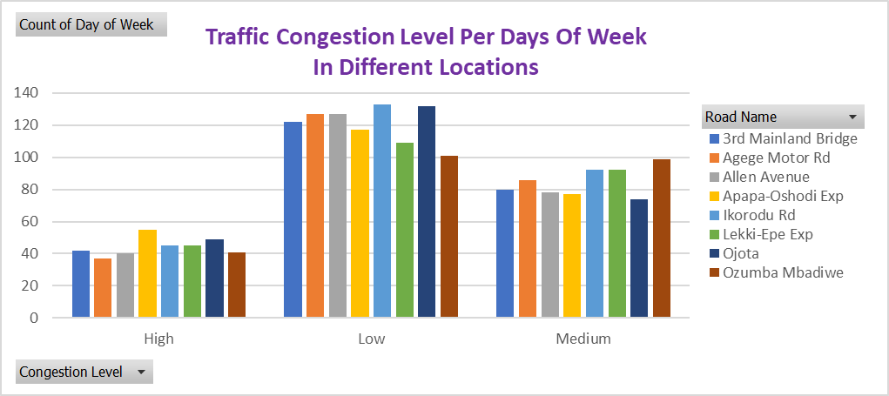

Slide 6
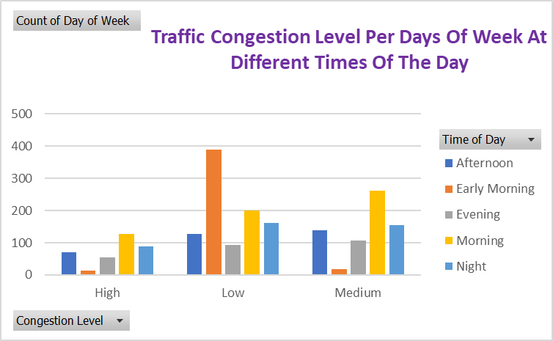

Slide 7
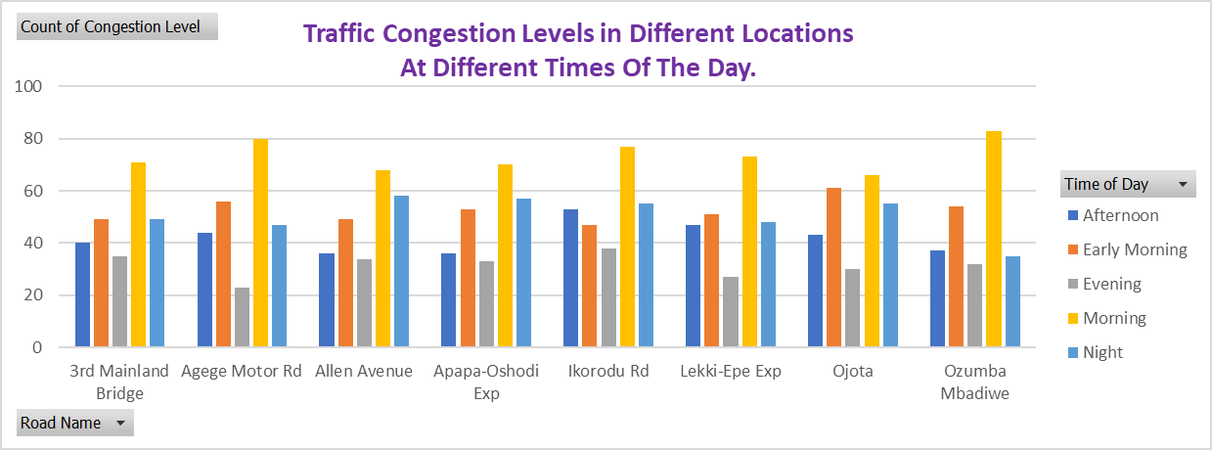

Slide 8
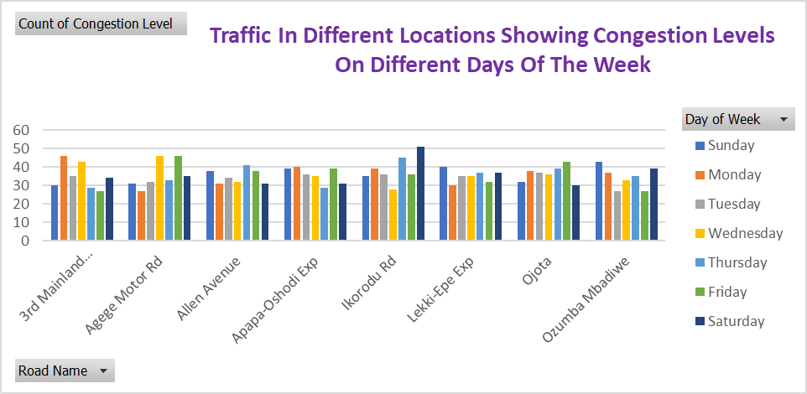

Slide 9
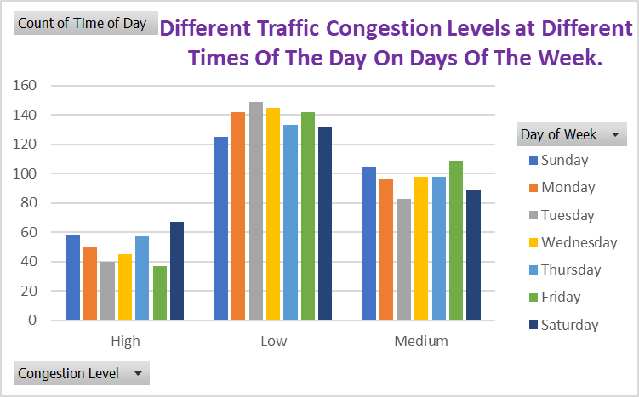

Slide 10
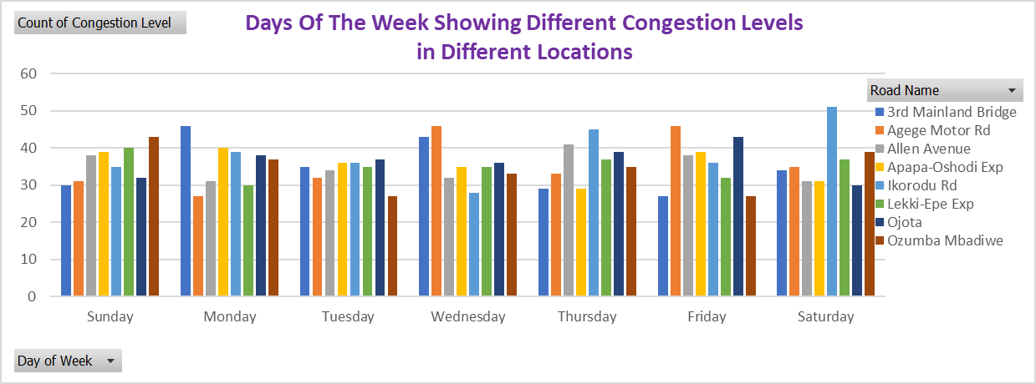

Slide 11
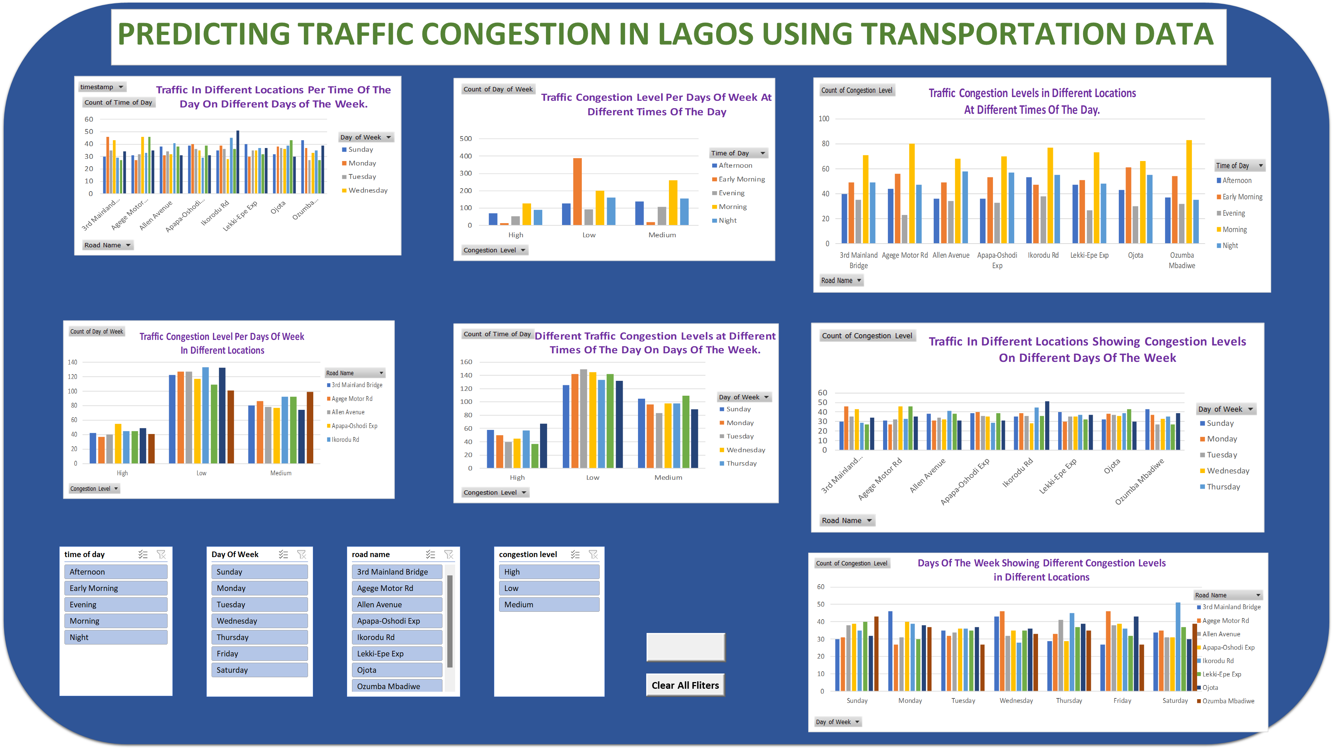

Slide 12


Slide 13
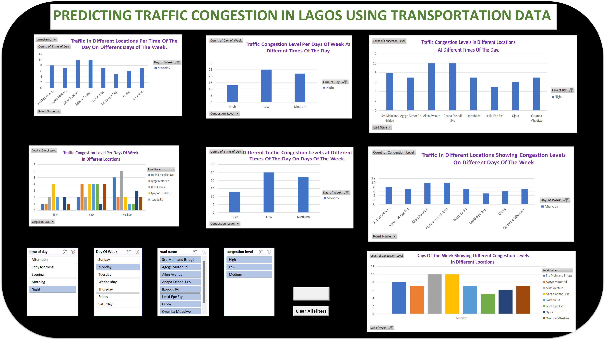

Slide 14
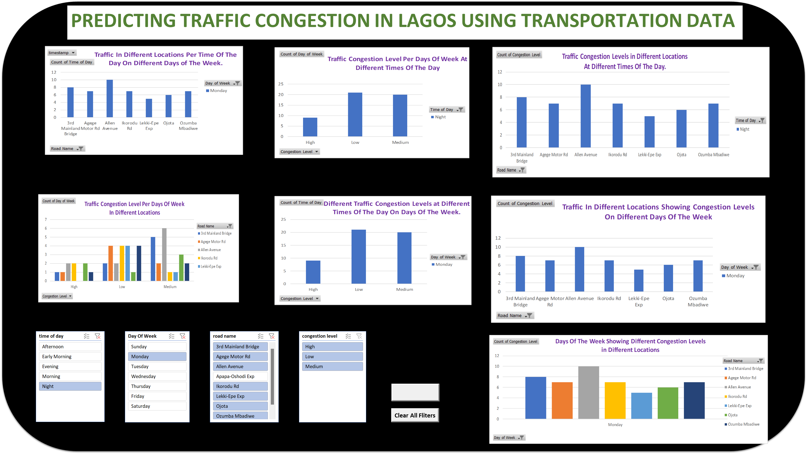

Slide 15
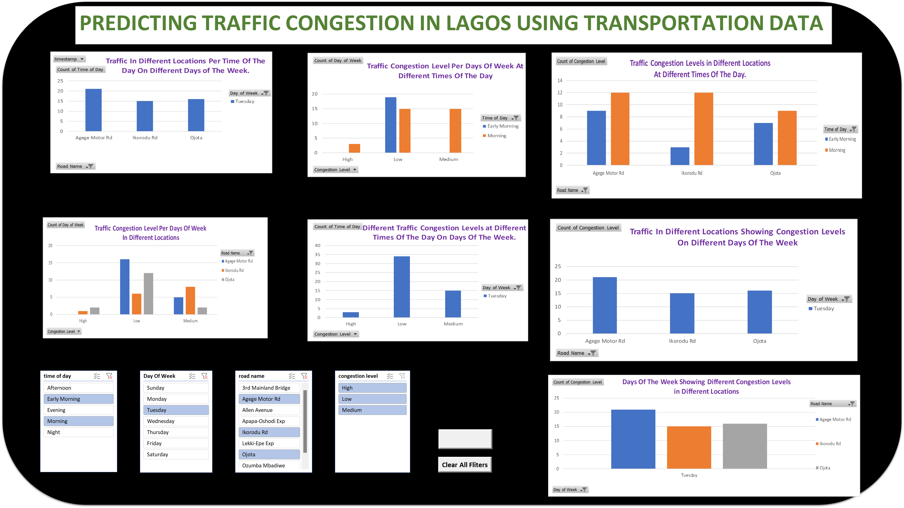

Slide 16
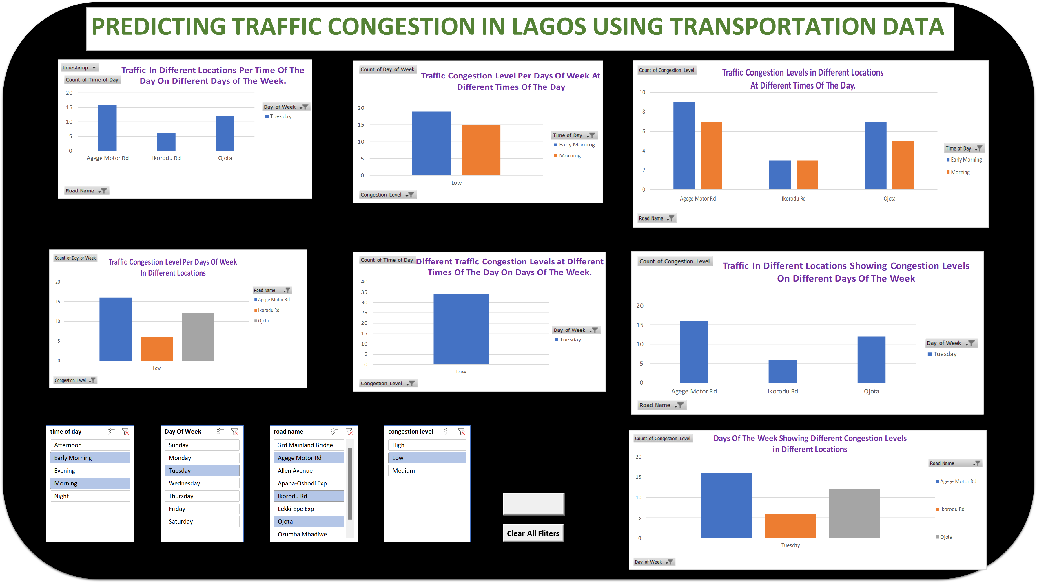

Slide 17
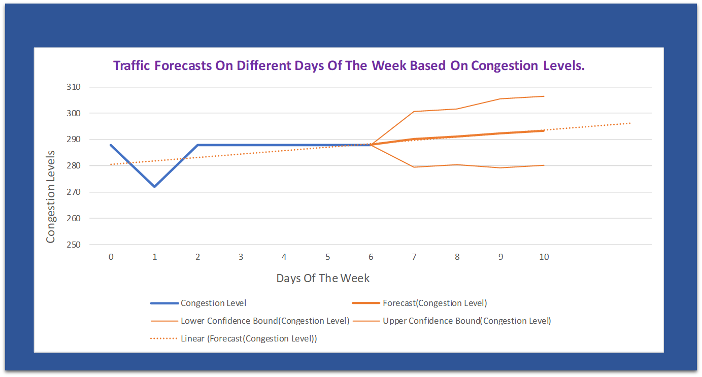
From the linear forecast trendline, The traffic data forecasts shows that as the week progresses, the congestion increases also. Meaning traffic is expected to be less at the beginning of the new week.

Slide 18
Indications:
The above results indicates that the peculiar behavior of individuals in the above listed locations is, they go out more often towards the end of the week than from beginning of the week, probably as a result of work structure or type of business.
Work structure being that more people who own businesses ply the roads in vehicles.

Slide 19
Thank You

